Slide 1
GIP6 Use Cases: MPLS and GRE
China Unicom
March 2023
研院 未来网络研究部

Slide 2




Scenario 1: MPLS+IPv6 in MAN-BN-IPRAN
In the scenario of cross domain enterprise dedicated line, business traffic needs to span multiple AS network domains with different bearer methods, including intelligent MAN, Backbone Networks (which can be inter provincial or intra provincial) and IPRAN.
MAN and BN generally deploy IPv6, while IPRAN deploys MPLS.
MAN A
Backbone Network
IP RAN B
A1
MER
MCR
AR
AR
RSG
ASG
A1
CSG
AR
AR
A1
MER
MCR
RSG
ASG
Site 1
MAR
CSG
Site 2
SRv6
eBGP
SRv6
LDP LSP
eBGP
VLAN
IPv6
VLAN
IPv6
VLAN
MPLS
VLAN

Slide 3
Scenario 2: MPLS+IPv6 in IPRAN-BN-IPRAN
In the scenario of business traffic spanning across IPRAN, BN and IPRAN.
IPRAN deploy MPLS, while BN deploys IPv6.
IP RAN A
Backbone Network
IP RAN B
AR
AR
ASG
RSG
RSG
ASG
CSG
CSG
AR
AR
CSG
ASG
RSG
RSG
ASG
CSG
Site 2
Site 1
LDP LSP
eBGP
SRv6
eBGP
LDP LSP
VLAN
MPLS
VLAN
IPv6
VLAN
MPLS
VLAN

Slide 4
Problem and Alternative Solution
Problem： When packets enter MPLS tunnels from IPv6 domain, information encapsulated in IPv6 header is lost, which prevents cross-domain fine-grained OAM/PM.
Option 1: Carry some IPv6 information in the MPLS packet
Legacy: MPLS devices SHOULD process upper layer payload hop-by-hop
MPLS extension header
Option 2: Encapsulate the MPLS tunnel information in the IPv6 extension header
IPv6 extension header: Devices in the MPLS domain need to support IPv6

Slide 5
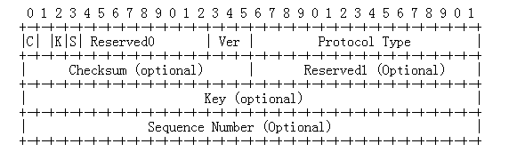
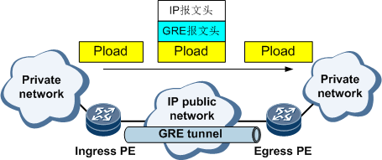
GRE requires to realize emerging and useful functionalities (iFIT, IOAM, slicing)
Problem:
Repetitive implementation of functionalities that is already done in IPv6
The header of the GRE packet cannot encapsulate more information due to lack of scalability.
Potential Solution: IPv6 extension header (if IPv6 underlay)
Side Effects: Required extension GRE header is placed underlay while the GRE header stays overlay.

Slide 6
Thanks

